Slide 1
The MinRank Problem in Cryptography and Cryptanalysis
Survey talk by Ray Perlner
Ray.Perlner@nist.gov
National Institute of Standards and Technology (US)

Slide 2
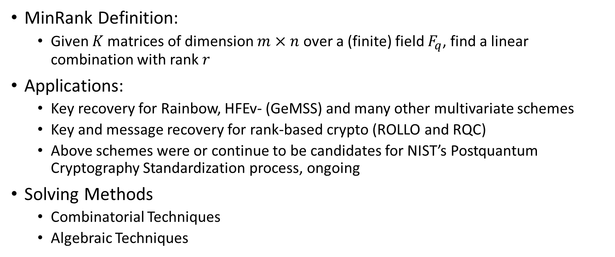
Overview
MinRank Definition:
  Given $K$ matrices of dimension $m×n$ over a (finite) field $F_{q}$, find a linear combination with rank $r$
Applications:
  Key recovery for Rainbow, HFEv- (GeMSS) and many other multivariate schemes
  Key and message recovery for rank-based crypto (ROLLO and RQC)
  Above schemes were or continue to be candidates for NIST’s Postquantum Cryptography Standardization process, ongoing
Solving Methods
  Combinatorial Techniques
  Algebraic Techniques

Slide 3
Part 1: Applications

Slide 4
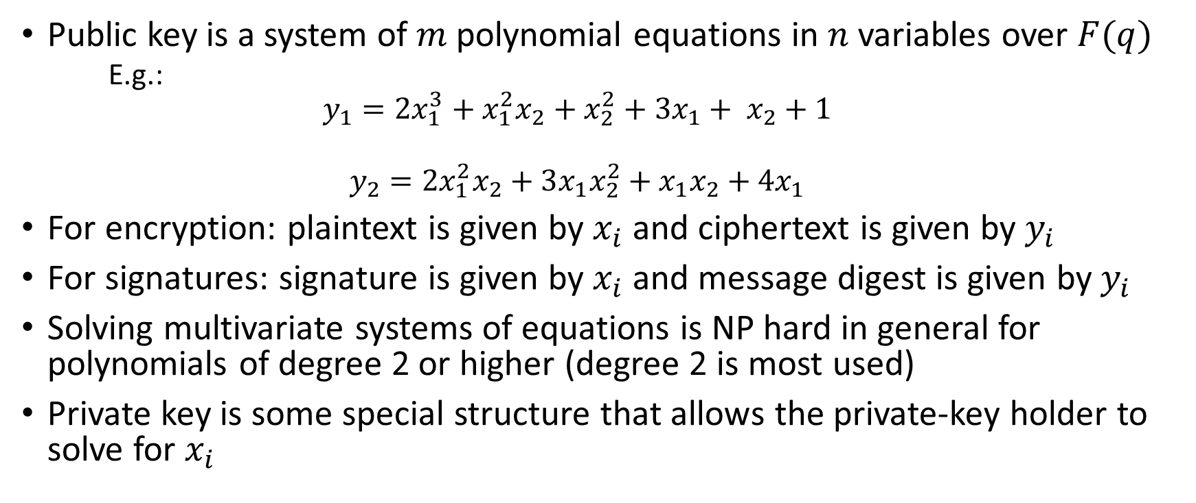
Multivariate Cryptography
Public key is a system of $m$ polynomial equations in $n$ variables over $F(q)$
  E.g.:
  $$y_{1}=2x_{1}^{3}+x_{1}^{2}x_{2}+x_{2}^{2}+3x_{1}+ x_{2}+1$$
  $$y_{2}=2x_{1}^{2}x_{2}+3x_{1}x_{2}^{2}+x_{1}x_{2}+4x_{1}$$
For encryption: plaintext is given by $x_{i}$ and ciphertext is given by $y_{i}$
For signatures: signature is given by $x_{i}$ and message digest is given by $y_{i}$
Solving multivariate systems of equations is NP hard in general for polynomials of degree 2 or higher (degree 2 is most used)
Private key is some special structure that allows the private-key holder to solve for $x_{i}$

Slide 5
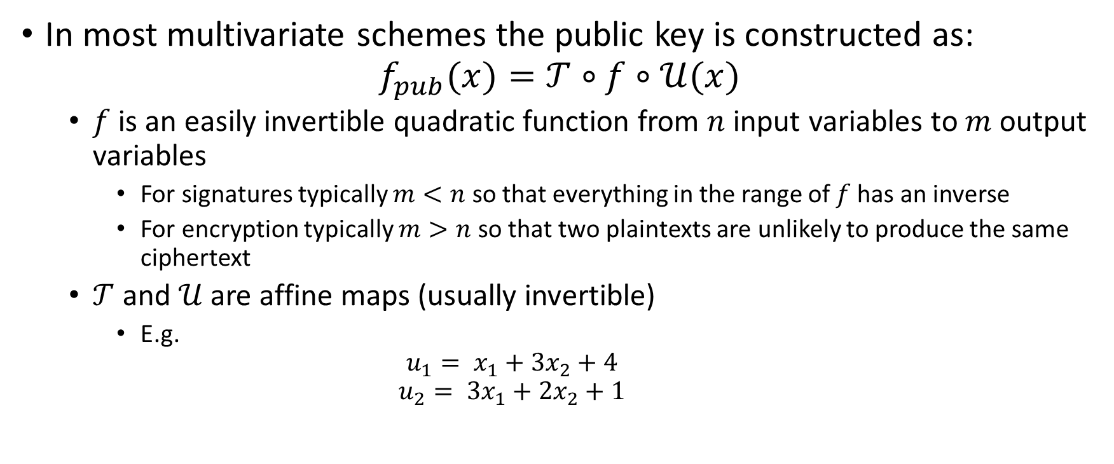
Multivariate Cryptography 2
Butterfly Construction
In most multivariate schemes the public key is constructed as:
$$f_{pub}(x)=𝒯∘f∘𝒰(x)$$
  $f$ is an easily invertible quadratic function from $n$ input variables to $m$ output variables
    For signatures typically $m<n$ so that everything in the range of $f$has an inverse
    For encryption typically $m>n$ so that two plaintexts are unlikely to produce the same ciphertext
  $𝒯$ and $𝒰$ are affine maps (usually invertible)
    E.g.
    $$u_{1}= x_{1}+3x_{2}+4$$
    $$u_{2}= {3x}_{1}+2x_{2}+1$$

Slide 6
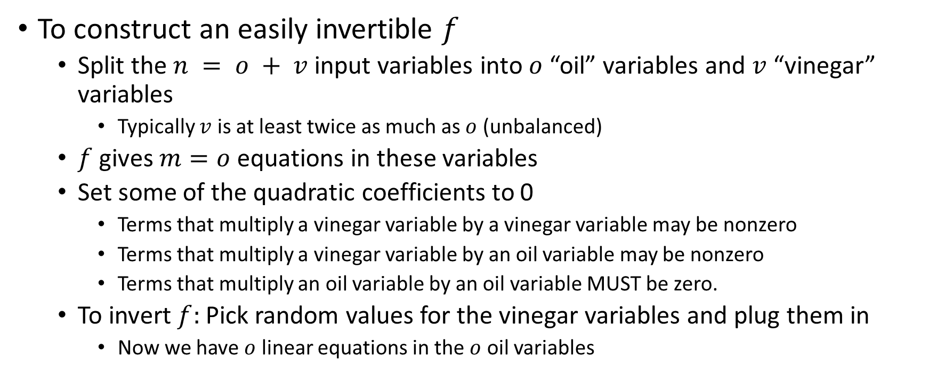
Unbalanced Oil and Vinegar
A Multivariate Scheme Not Vulnerable to MinRank
To construct an easily invertible $f$
  Split the $n = o + v$input variables into $o$ “oil” variables and $v$ “vinegar” variables
    Typically $v$ is at least twice as much as $o$ (unbalanced)
  $f$ gives $m=o$ equations in these variables
  Set some of the quadratic coefficients to 0
    Terms that multiply a vinegar variable by a vinegar variable may be nonzero
    Terms that multiply a vinegar variable by an oil variable may be nonzero
    Terms that multiply an oil variable by an oil variable MUST be zero.
  To invert $f:$ Pick random values for the vinegar variables and plug them in
    Now we have $o$ linear equations in the $o$ oil variables

Slide 7
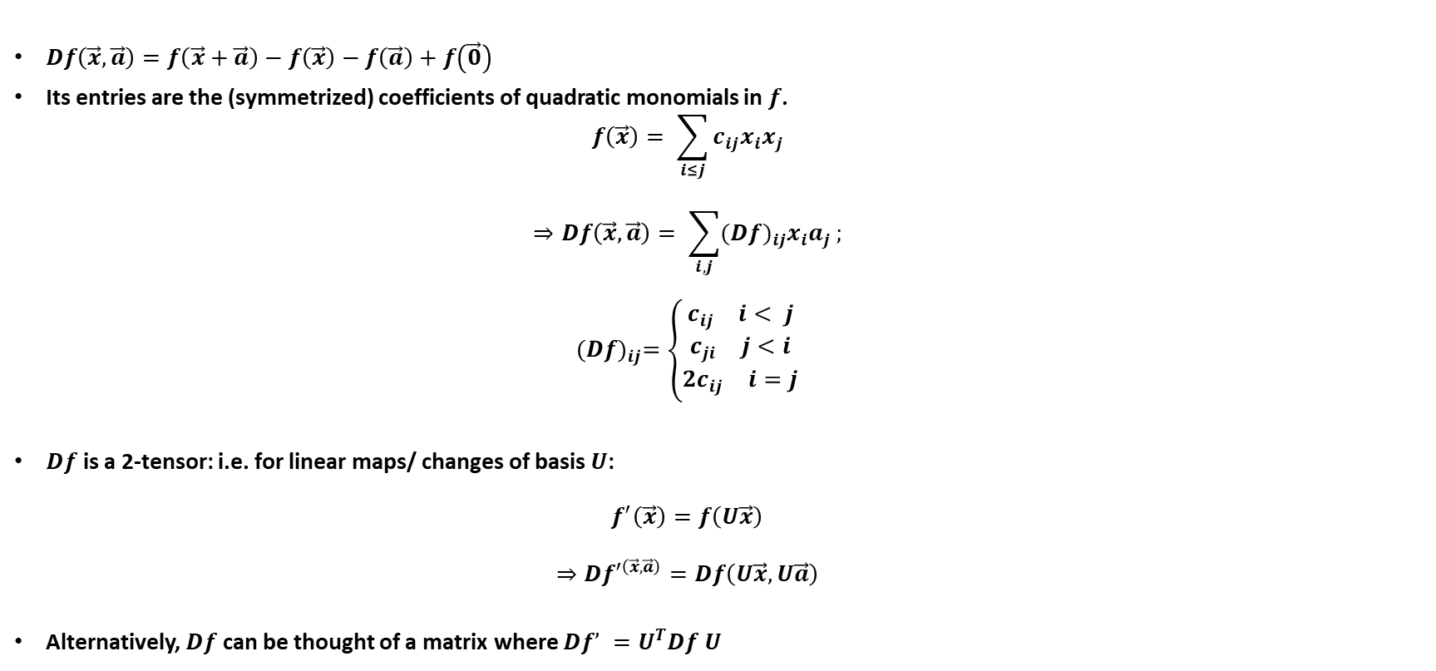

Matrix Representation of $f$
Using the Discrete Differential
$Df\left(\vec{x},\vec{a}\right)=f\left(\vec{x}+\vec{a}\right)−f\left(\vec{x}\right)−f\left(\vec{a}\right)+f\left(\vec{0}\right)$
Its entries are the (symmetrized) coefficients of quadratic monomials in $f$.
  $$f\left(\vec{x}\right)= \sum_{i≤j}{c_{ij}x_{i}x_{j}}$$
  $$⇒Df\left(\vec{x},\vec{a}\right)= \sum_{i,j}{({Df)}_{ij}x_{i}a_{j}};$$
  $${(Df)}_{ij}=\left\{\begin{matrix}\begin{aligned}\begin{matrix}c_{ij} & i< j\end{matrix} \\ \begin{matrix}c_{ji} & j<i\end{matrix}\end{aligned} \\ \begin{matrix}{2c}_{ij} & i=j\end{matrix}\end{matrix}\right.$$
$Df$ is a 2-tensor: i.e. for linear maps/ changes of basis $U$:
  $$f^{′}\left(\vec{x}\right)=f\left(U\vec{x}\right)$$
  $$⇒Df^{′\left(\vec{x},\vec{a}\right)}=Df\left(U\vec{x},U\vec{a}\right)$$
Alternatively, $Df$ can be thought of a matrix where $Df’ =U^{T}Df U$

Slide 8
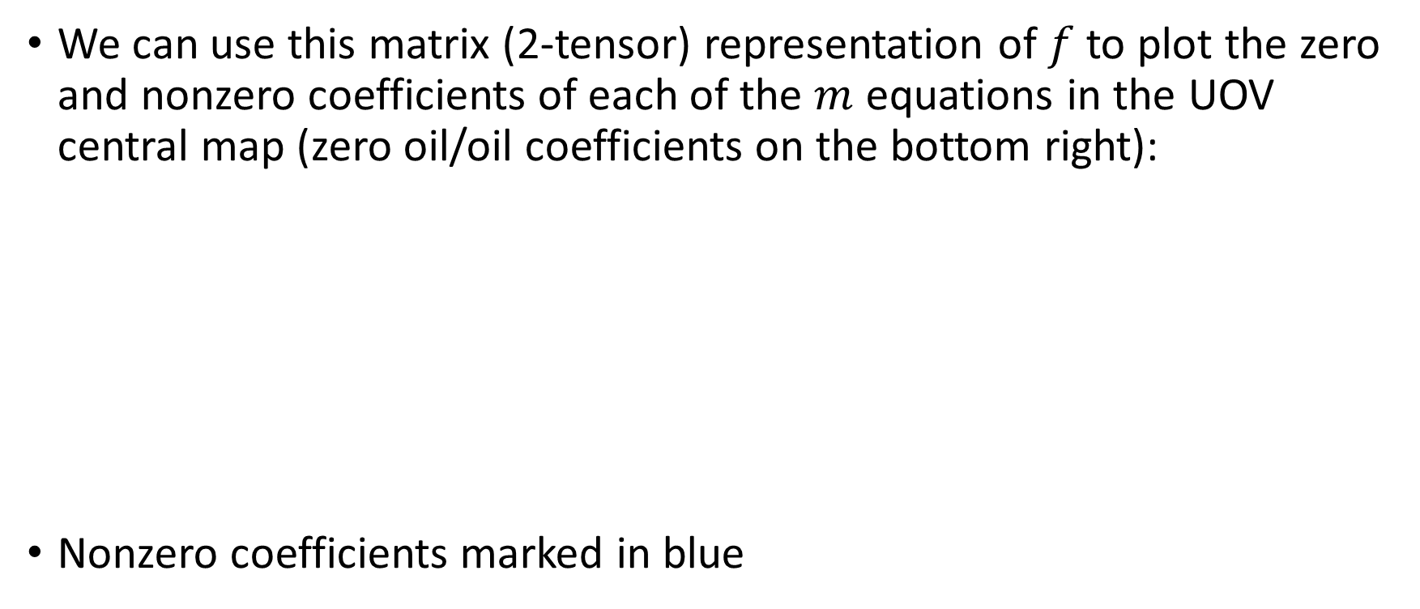

Matrix representation of $f$
We can use this matrix (2-tensor) representation of $f$ to plot the zero and nonzero coefficients of each of the $m$ equations in the UOV central map (zero oil/oil coefficients on the bottom right):
Nonzero coefficients marked in blue

Slide 9
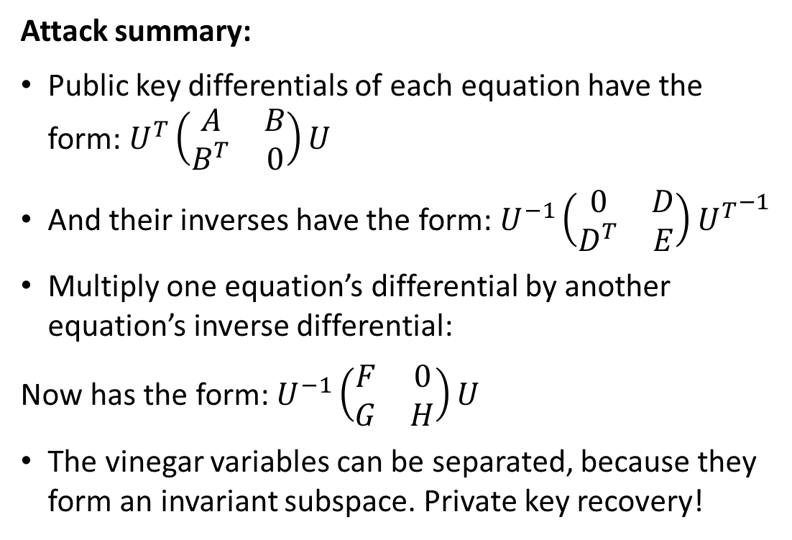
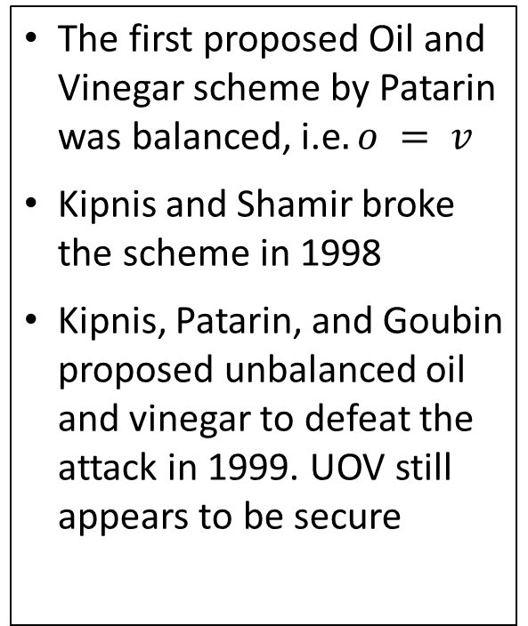
Why Unbalanced?
Attack summary:
Public key differentials of each equation have the form: $U^{T}\left(\begin{matrix}A & B \\ B^{T} & 0\end{matrix}\right)U$
And their inverses have the form: $U^{−1}\left(\begin{matrix}0 & D \\ D^{T} & E\end{matrix}\right){U^{T}}^{−1}$
Multiply one equation’s differential by another equation’s inverse differential:
Now has the form: $U^{−1}\left(\begin{matrix}F & 0 \\ G & H\end{matrix}\right)U$
The vinegar variables can be separated, because they form an invariant subspace. Private key recovery!
The first proposed Oil and Vinegar scheme by Patarin was balanced, i.e$. o = v$
Kipnis and Shamir broke the scheme in 1998
Kipnis, Patarin, and Goubin proposed unbalanced oil and vinegar to defeat the attack in 1999. UOV still appears to be secure

Slide 10
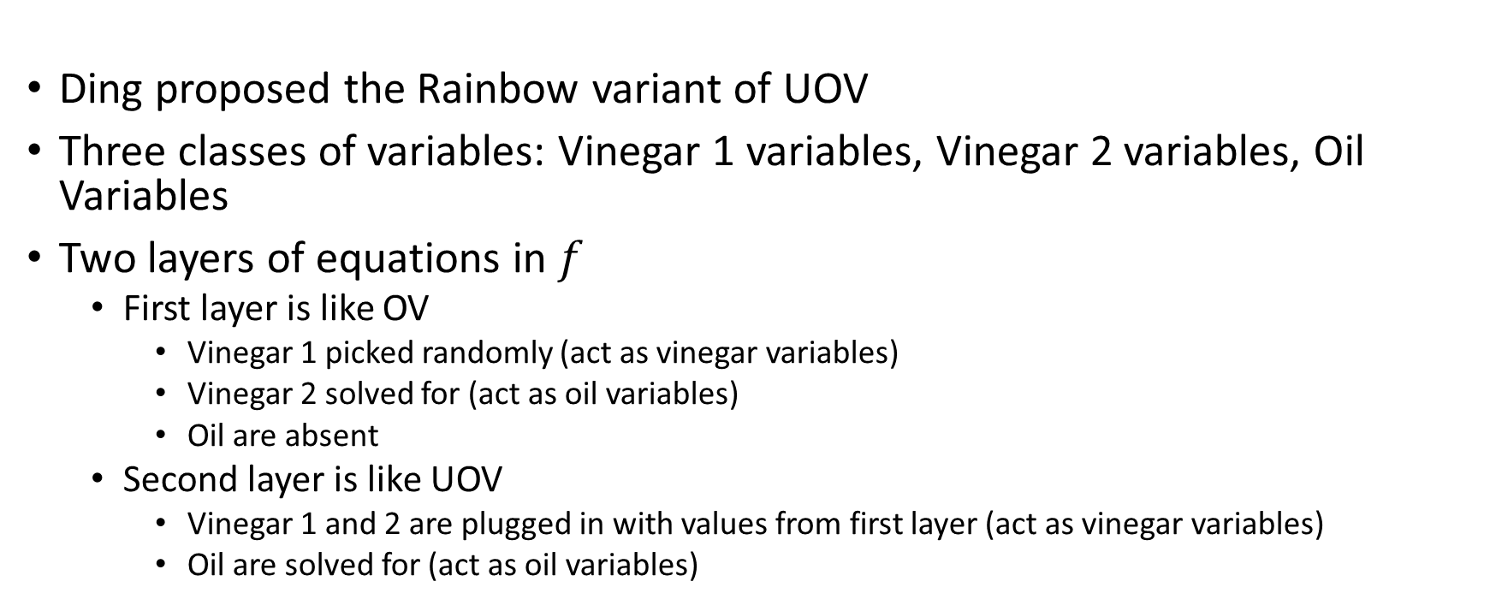
Rainbow:
A Variant of UOV Attackable with MinRank
Ding proposed the Rainbow variant of UOV
Three classes of variables: Vinegar 1 variables, Vinegar 2 variables, Oil Variables
Two layers of equations in $f$
  First layer is like OV
    Vinegar 1 picked randomly (act as vinegar variables)
    Vinegar 2 solved for (act as oil variables)
    Oil are absent
  Second layer is like UOV
    Vinegar 1 and 2 are plugged in with values from first layer (act as vinegar variables)
    Oil are solved for (act as oil variables)

Slide 11
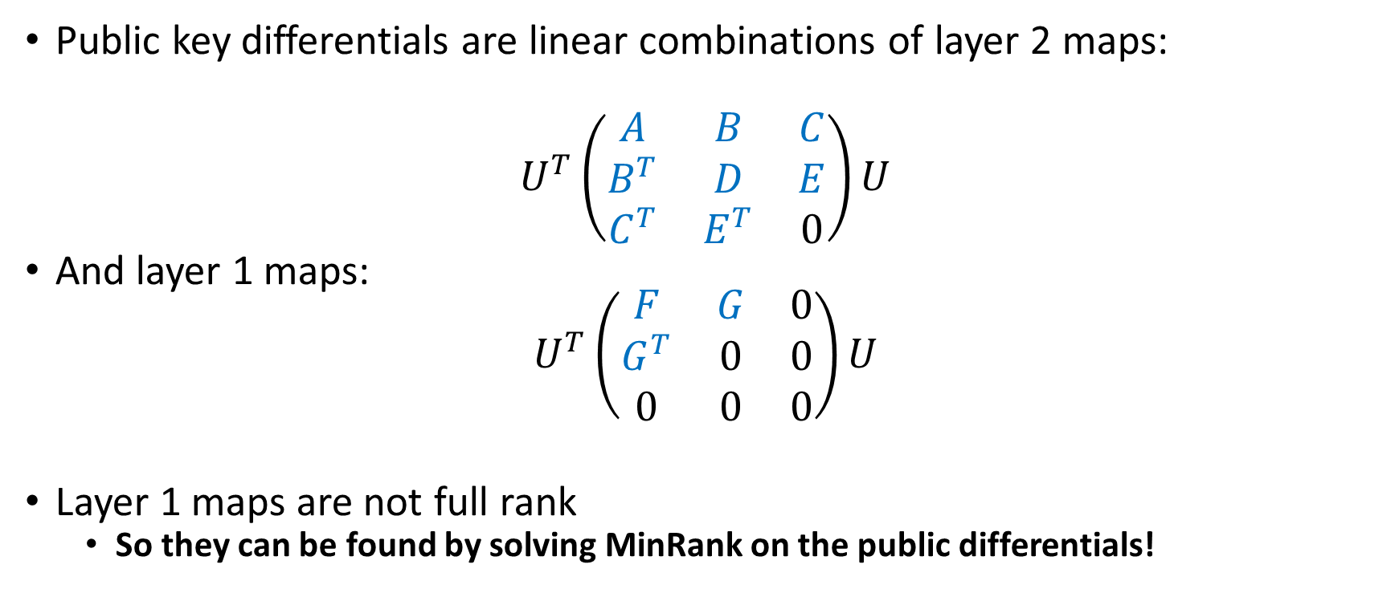
Rainbow and MinRank
Public key differentials are linear combinations of layer 2 maps:
$$U^{T}\left(\begin{matrix}A & B & C \\ B^{T} & D & E \\ C^{T} & E^{T} & 0\end{matrix}\right)U$$
And layer 1 maps:
$$U^{T}\left(\begin{matrix}F & G & 0 \\ G^{T} & 0 & 0 \\ 0 & 0 & 0\end{matrix}\right)U$$
Layer 1 maps are not full rank
  So they can be found by solving MinRank on the public differentials!

Slide 12
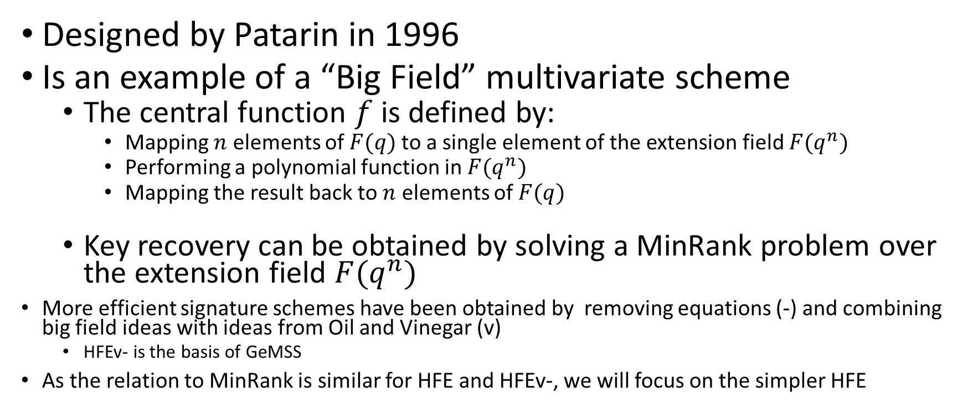
Another Multivariate Example:
Hidden Field Equations (HFE)
Designed by Patarin in 1996
Is an example of a “Big Field” multivariate scheme
  The central function $f$ is defined by:
    Mapping $n$ elements of $F(q)$to a single element of the extension field $F(q^{n})$
    Performing a polynomial function in $F(q^{n})$
    Mapping the result back to $n$ elements of $F(q)$
  Key recovery can be obtained by solving a MinRank problem over the extension field $F(q^{n})$
More efficient signature schemes have been obtained by removing equations (-) and combining big field ideas with ideas from Oil and Vinegar (v)
  HFEv- is the basis of GeMSS
As the relation to MinRank is similar for HFE and HFEv-, we will focus on the simpler HFE

Slide 13
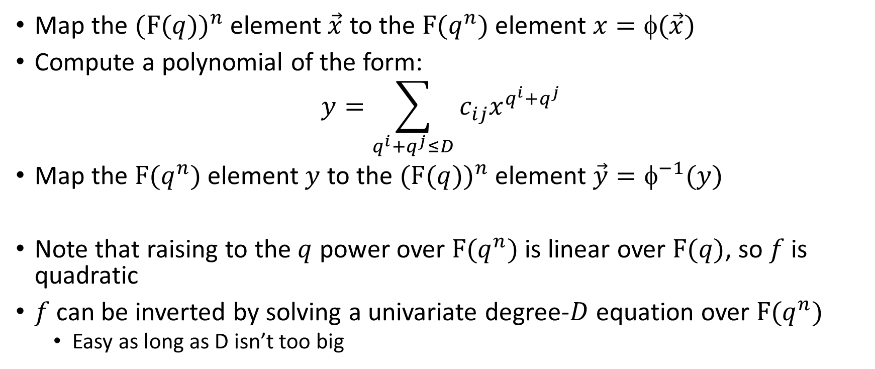

The HFE central map $\vec{y}=f(\vec{x})$
Map the $({F(q))}^{n}$ element $\vec{x}$ to the $F(q^{n})$ element $x=φ(\vec{x})$
Compute a polynomial of the form:
$$y=\sum_{q^{i}+q^{j}≤D}{c_{ij}x^{q^{i}+q^{j}}}$$
Map the $F(q^{n})$ element $y$ to the $({F(q))}^{n}$ element $\vec{y}=φ^{−1}(y)$
Note that raising to the $q$ power over $F(q^{n})$ is linear over $F(q)$, so $f$ is quadratic
$f$ can be inverted by solving a univariate degree-$D$ equation over $F(q^{n})$
  Easy as long as D isn’t too big

Slide 14
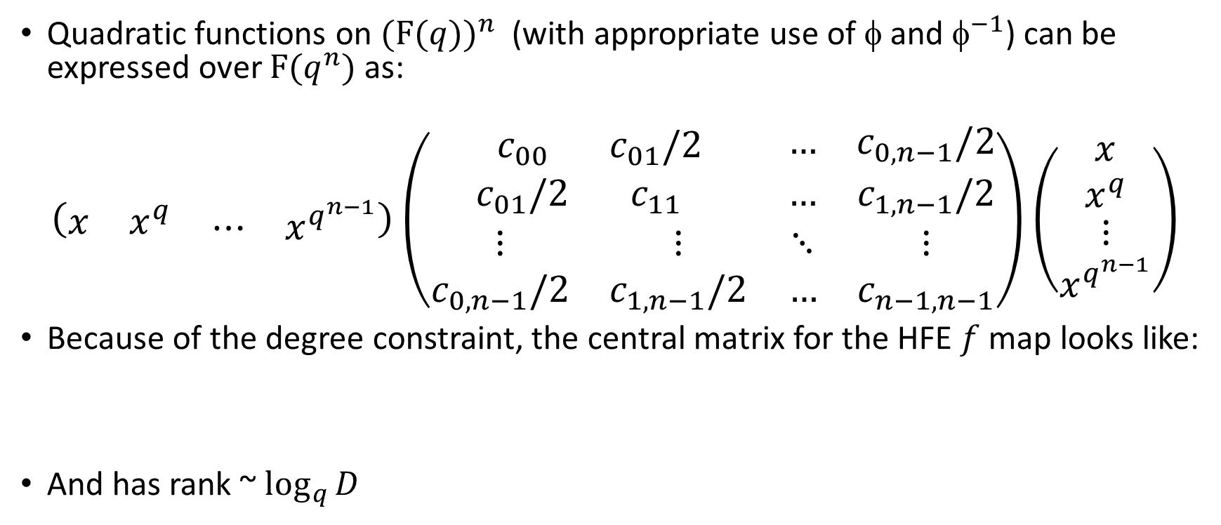
HFE and MinRank
[Kipnis Shamir 1999]
Quadratic functions on $({F(q))}^{n}$ (with appropriate use of $$ and $^{−1}$) can be expressed over $F(q^{n})$ as:
$$\left(\begin{matrix}\begin{matrix}x & x^{q}\end{matrix} & \begin{matrix}⋯ & x^{q^{n−1}}\end{matrix}\end{matrix}\right)\left(\begin{matrix}\begin{matrix}c_{00} & c_{01}/2 \\ c_{01}/2 & c_{11}\end{matrix} & \begin{matrix}… & c_{0,n−1}/2 \\ … & c_{1,n−1}/2\end{matrix} \\ \begin{matrix}⋮ & ⋮ \\ c_{0,n−1}/2 & c_{1,n−1}/2\end{matrix} & \begin{matrix}⋱ & ⋮ \\ … & c_{n−1,n−1}\end{matrix}\end{matrix}\right)\left(\begin{matrix}\begin{matrix}x \\ x^{q}\end{matrix} \\ \begin{matrix}⋮ \\ x^{q^{n−1}}\end{matrix}\end{matrix}\right)$$
Because of the degree constraint, the central matrix for the HFE $f$ map looks like:
And has rank ~ $\log_{q}{D}$

Slide 15
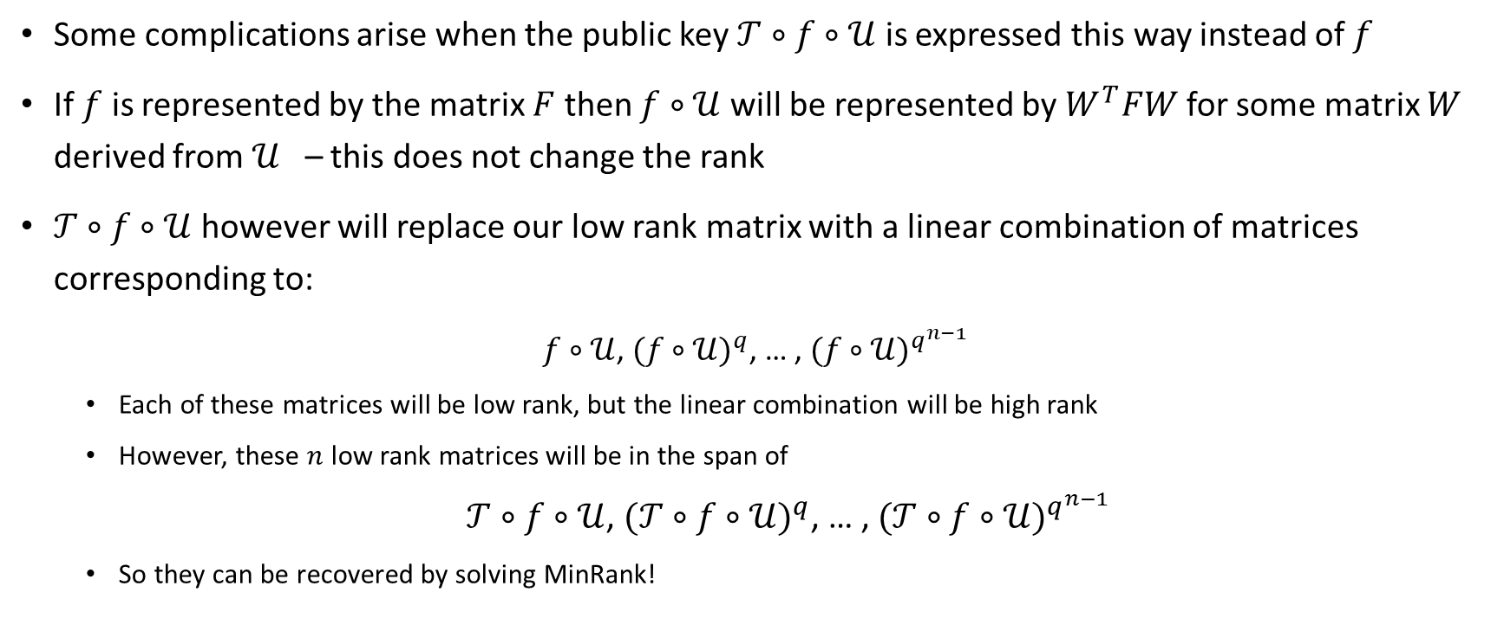
HFE and MinRank Cont.
[Kipnis Shamir 1999]
Some complications arise when the public key $𝒯∘f∘𝒰$ is expressed this way instead of $f$
If $f$ is represented by the matrix $F$ then $f∘𝒰$ will be represented by $W^{T}FW$ for some matrix $W$ derived from $𝒰$ – this does not change the rank
$𝒯∘f∘𝒰$ however will replace our low rank matrix with a linear combination of matrices corresponding to:
$f∘𝒰$, ${(f∘𝒰)}^{q}$, … , ${(f∘𝒰)}^{q^{n−1}}$
  Each of these matrices will be low rank, but the linear combination will be high rank
  However, these $n$ low rank matrices will be in the span of
  $𝒯∘f∘𝒰$, ${(𝒯∘f∘𝒰)}^{q}$, … , ${(𝒯∘f∘𝒰)}^{q^{n−1}}$
  So they can be recovered by solving MinRank!

Slide 16
MinRank in Code Based Crypto
Rank Metric Codes

Slide 17

Rank Metric
Applies to vectors over $GF\left(q^{m}\right)$
Use a basis over $GF(q)$ to rewrite an $n$-dimensional vector over $GF\left(q^{m}\right)$ as an $n×m$ matrix over $GF(q)$
  Compute the rank
E.g. under the basis $(1,x,x^{2})$ for $GF(2^{3})$:
$$(1+x,0,1+x^{2},1+x,x^{2}+x)$$
Becomes
$$\left(\begin{matrix}\begin{matrix}\begin{matrix}1 \\ 1 \\ 0\end{matrix} & \begin{matrix}0 \\ 0 \\ 0\end{matrix}\end{matrix} & \begin{matrix}\begin{matrix}1 \\ 0 \\ 1\end{matrix} & \begin{matrix}1 \\ 1 \\ 0\end{matrix} & \begin{matrix}0 \\ 1 \\ 1\end{matrix}\end{matrix}\end{matrix}\right)$$
Which has rank 2

Slide 18
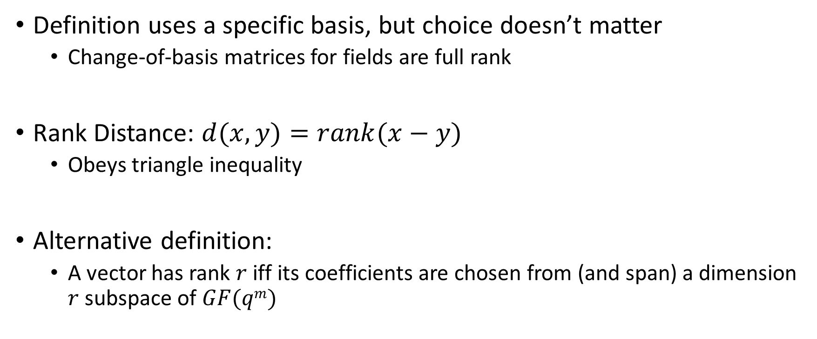
Properties of the Rank Metric
Definition uses a specific basis, but choice doesn’t matter
  Change-of-basis matrices for fields are full rank
Rank Distance: $d(x,y)=rank(x−y)$
  Obeys triangle inequality
Alternative definition:
  A vector has rank $r$ iff its coefficients are chosen from (and span) a dimension $r$ subspace of $GF(qm)$

Slide 19
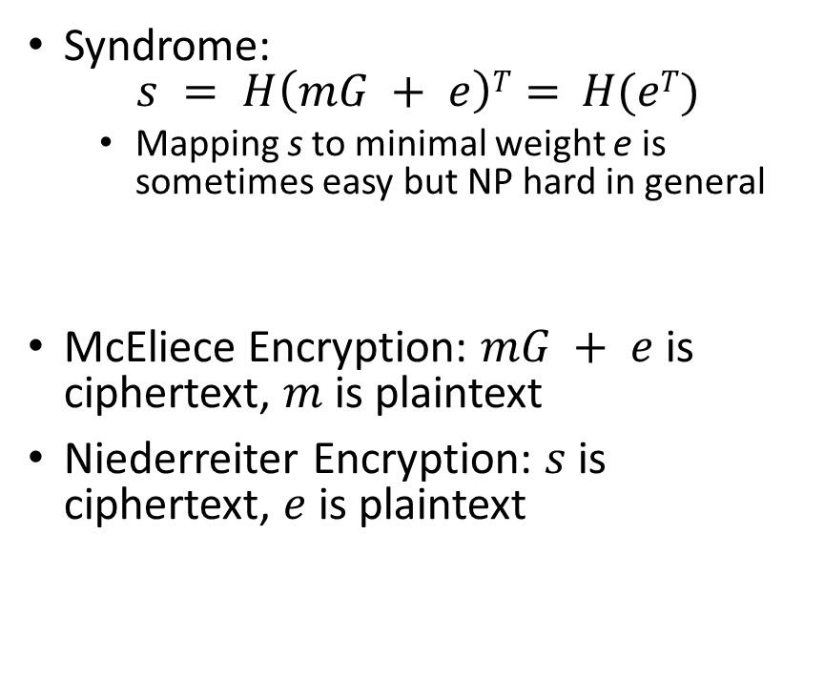
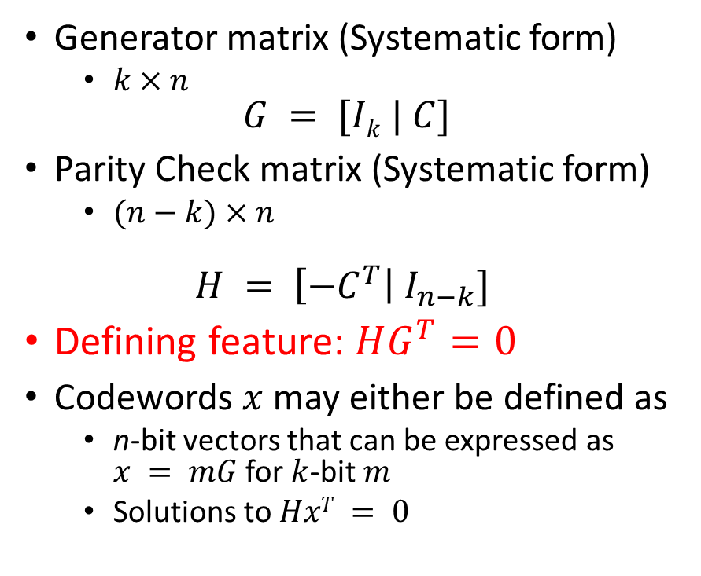
Some Coding Theory
Generator matrix (Systematic form)
  $k×n$
$$G = [Ik | C]$$
Parity Check matrix (Systematic form)
  $(n−k)×n$
$$H = \left[{−C}^{T}\right| I_{n−k}]$$
Defining feature: $HG^{T}=0$
Codewords $x$ may either be defined as
  n-bit vectors that can be expressed as $x = mG$ for $k$-bit $m$
  Solutions to $HxT = 0$
Syndrome:
$$s = H\left(mG + e\right)T= H(eT)$$
  Mapping s to minimal weight e is sometimes easy but NP hard in general
McEliece Encryption: $mG + e$is ciphertext, $m$ is plaintext
Niederreiter Encryption: $s$ is ciphertext, $e$ is plaintext

Slide 20
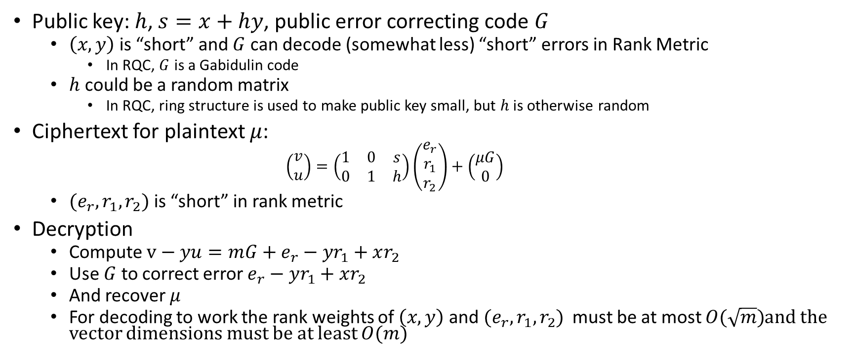
Example scheme: RQC
Public key: $h$, $s=x+hy$, public error correcting code $G$
  $\left(x,y\right)$ is “short” and $G$ can decode (somewhat less) “short” errors in Rank Metric
    In RQC, $G$ is a Gabidulin code
  $h$ could be a random matrix
    In RQC, ring structure is used to make public key small, but $h$ is otherwise random
Ciphertext for plaintext $μ$:
    $$\left(\begin{matrix}v \\ u\end{matrix}\right)=\left(\begin{matrix}1 & 0 & s \\ 0 & 1 & h\end{matrix}\right)\left(\begin{matrix}e_{r} \\ r_{1} \\ r_{2}\end{matrix}\right)+\left(\begin{matrix}μG \\ 0\end{matrix}\right)$$
  $(e_{r},r_{1},r_{2})$ is “short” in rank metric
Decryption
  Compute $v−yu={mG+e}_{r}−yr_{1}+xr_{2}$
  Use $G$ to correct error $e_{r}−yr_{1}+xr_{2}$
  And recover $μ$
  For decoding to work the rank weights of $\left(x,y\right)$ and $(e_{r},r_{1},r_{2})$ must be at most $O(\sqrt{m})$and the vector dimensions must be at least $O(m)$

Slide 21
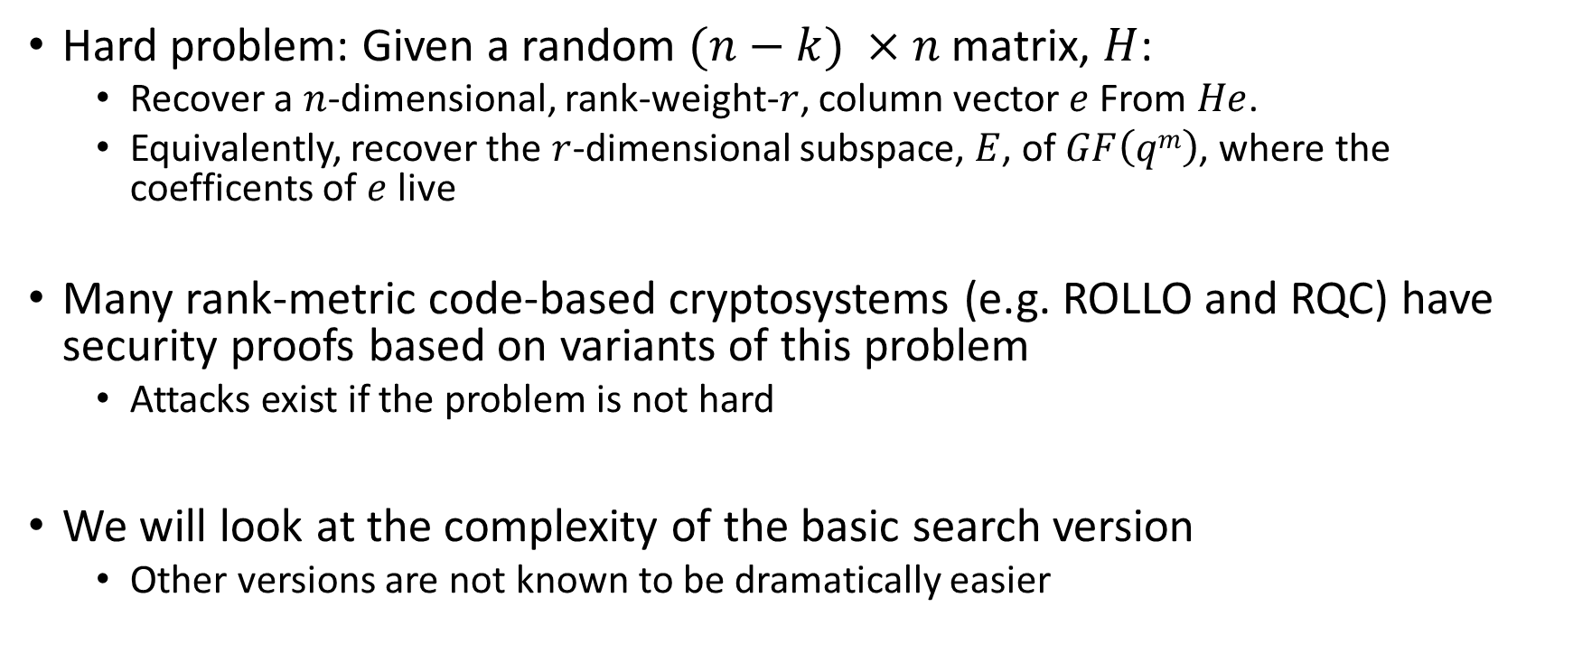
Rank Syndrome Decoding (RSD)
Hard problem: Given a random $(n−k) ×n$ matrix, $H$:
  Recover a $n$-dimensional, rank-weight-$r$, column vector $e$ From $He$.
  Equivalently, recover the $r$-dimensional subspace, $E$, of $GF\left(qm\right)$, where the coefficents of $e$ live
Many rank-metric code-based cryptosystems (e.g. ROLLO and RQC) have security proofs based on variants of this problem
  Attacks exist if the problem is not hard
We will look at the complexity of the basic search version
  Other versions are not known to be dramatically easier

Slide 22
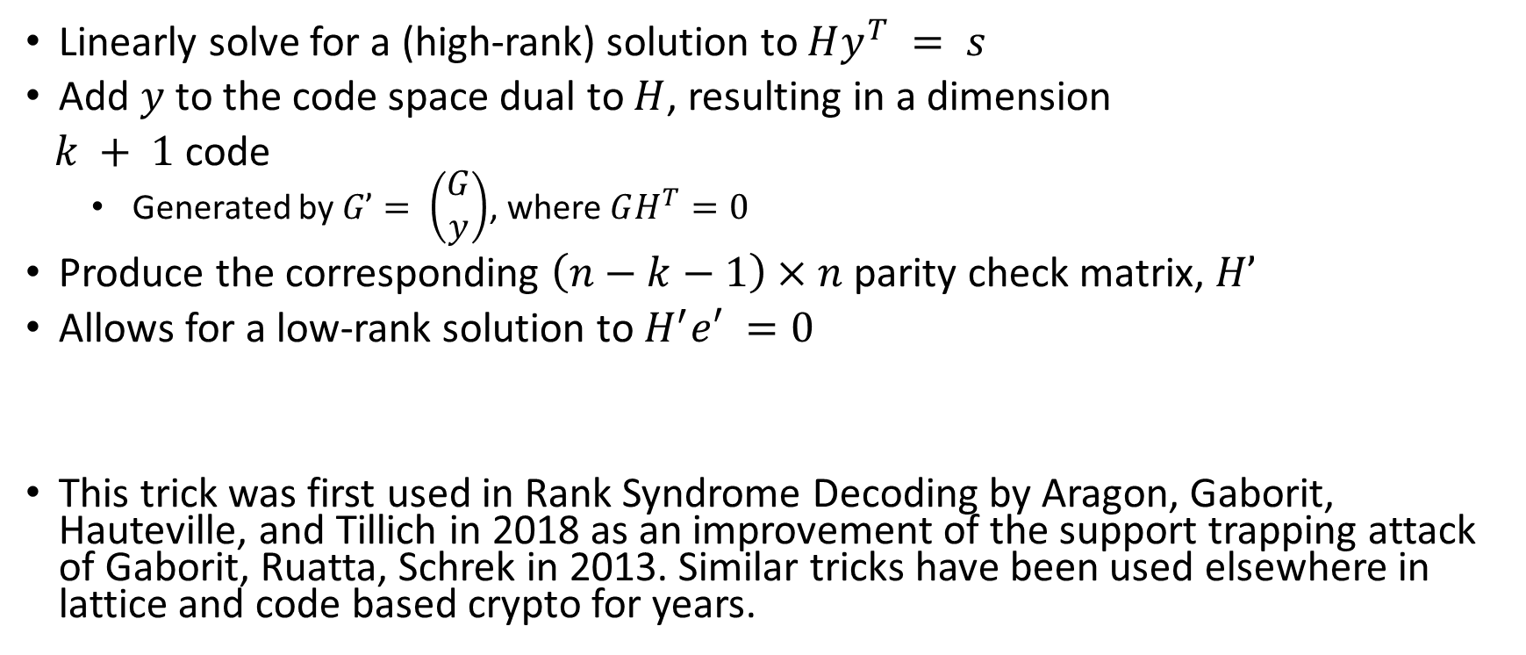
RSD as Low-Rank Codeword Search
Linearly solve for a (high-rank) solution to $Hy^{T} = s$
Add $y$ to the code space dual to $H$, resulting in a dimension
$k + 1$code
  Generated by $G’= \left(\begin{matrix}G \\ y\end{matrix}\right)$, where $GH^{T}=0$
Produce the corresponding $\left(n−k−1\right)×n$ parity check matrix, $H’$
Allows for a low-rank solution to $H^{′}e′ =0$
This trick was first used in Rank Syndrome Decoding by Aragon, Gaborit, Hauteville, and Tillich in 2018 as an improvement of the support trapping attack of Gaborit, Ruatta, Schrek in 2013. Similar tricks have been used elsewhere in lattice and code based crypto for years.

Slide 23
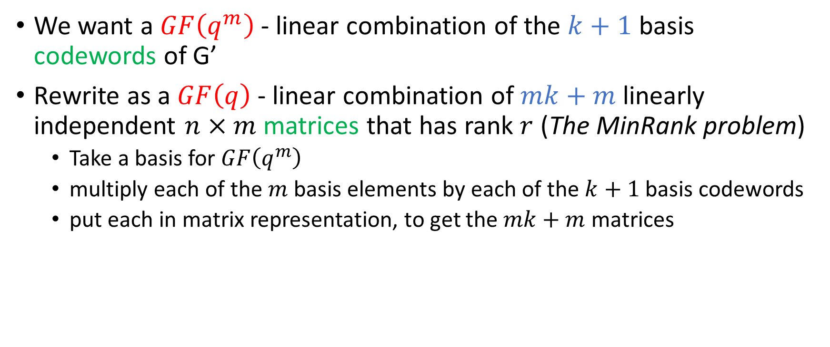
Rank Syndrome Decoding as MinRank
We want a $GF\left(q^{m}\right)$ - linear combination of the $k+1$ basis codewords of G’
Rewrite as a $GF\left(q\right)$ - linear combination of $mk+m$ linearly independent $n×m$matrices that has rank $r$ (The MinRank problem)
  Take a basis for $GF\left(q^{m}\right)$
  multiply each of the $m$ basis elements by each of the $k+1$basis codewords
  put each in matrix representation, to get the $mk+m$ matrices

Slide 24
Part 2: Solving Techniques

Slide 25
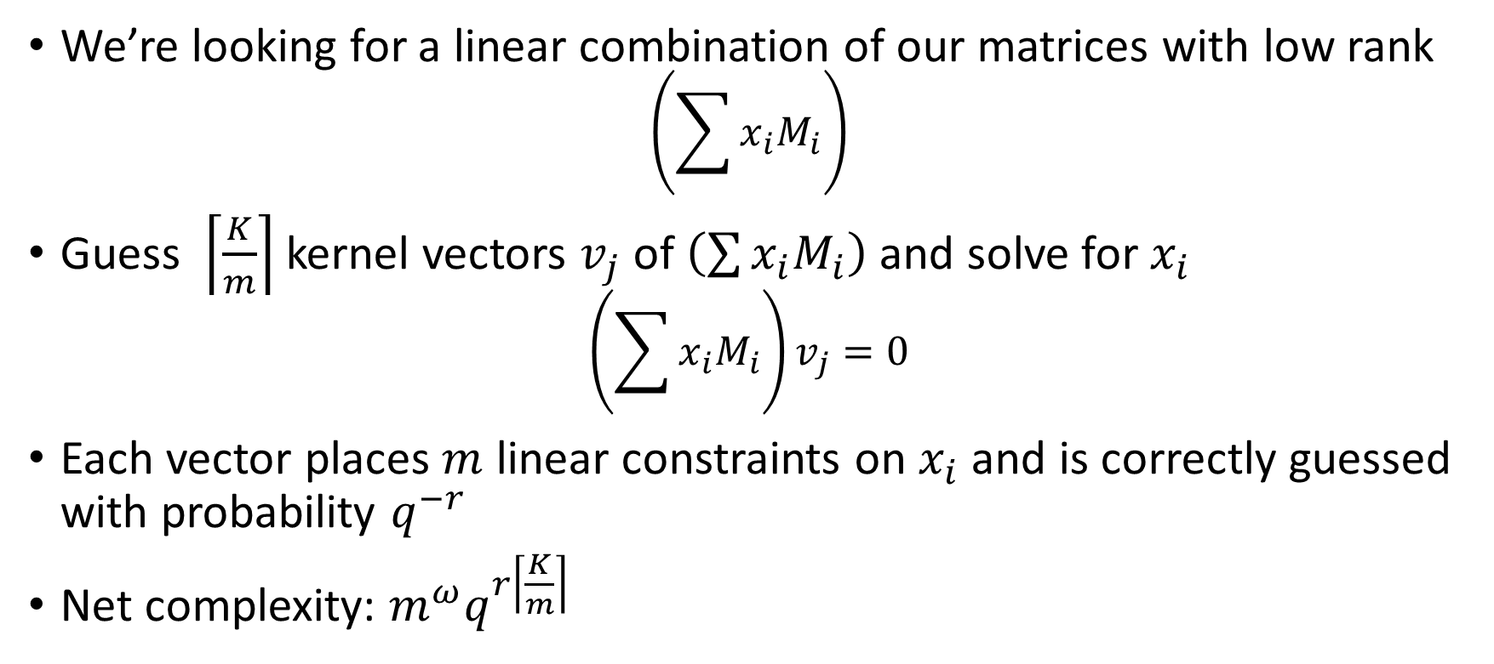
Combinatorial Techniques
Example: Linear Algebra Search
We’re looking for a linear combination of our matrices with low rank
$$\left(\sum{x_{i}M_{i}}\right)$$
Guess $\left\lceil \frac{K}{m}\right\rceil$ kernel vectors $v_{j}$ of $\left(\sum{x_{i}M_{i}}\right)$ and solve for $x_{i}$
$$\left(\sum{x_{i}M_{i}}\right)v_{j}=0$$
Each vector places $m$ linear constraints on $x_{i}$ and is correctly guessed with probability $q^{−r}$
Net complexity: $m^{ω}q^{r\left\lceil \frac{K}{m}\right\rceil }$

Slide 26
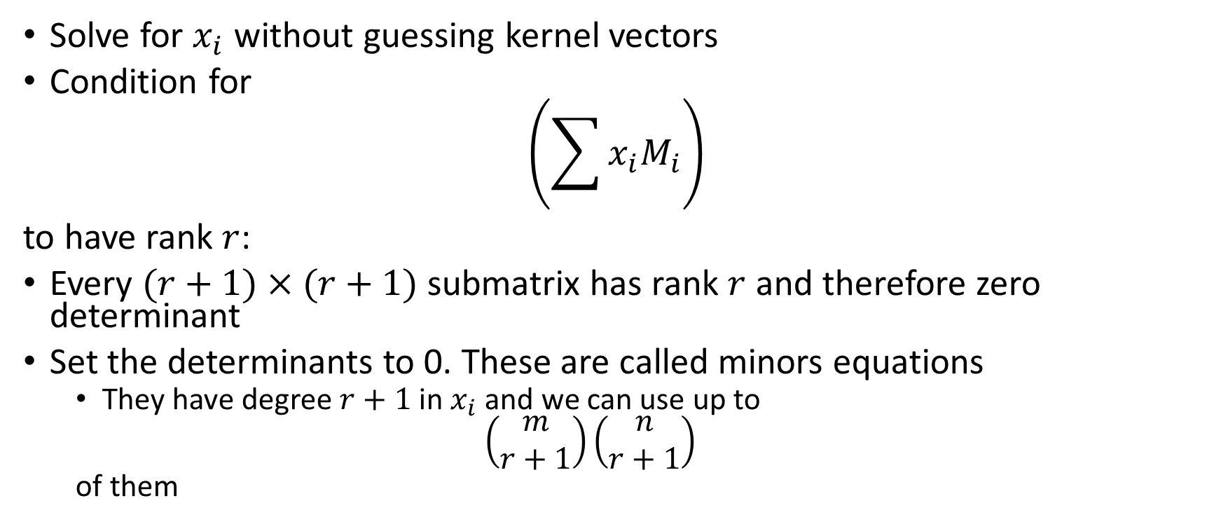
Algebraic Techniques
Example: Minors Modeling
Solve for $x_{i}$ without guessing kernel vectors
Condition for
$$\left(\sum{x_{i}M_{i}}\right)$$
to have rank $r$:
Every $(r+1)×(r+1)$ submatrix has rank $r$ and therefore zero determinant
Set the determinants to 0. These are called minors equations
  They have degree $r+1$ in $x_{i}$ and we can use up to
  $$\left(\begin{matrix}m \\ r+1\end{matrix}\right)\left(\begin{matrix}n \\ r+1\end{matrix}\right)$$
  of them

Slide 27
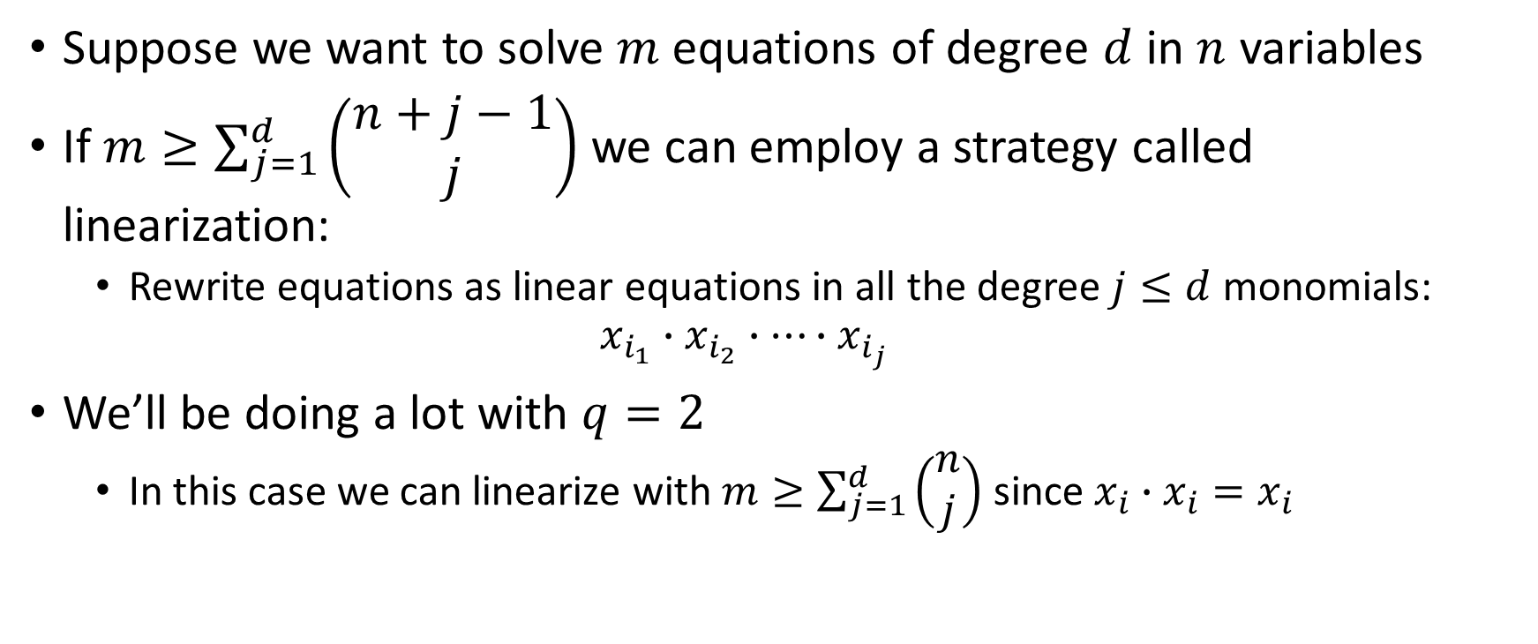
Solving polynomial systems
General strategy: Linearization
Suppose we want to solve $m$ equations of degree $d$ in $n$ variables
If $m≥\sum_{j=1}^{d}{\left(\begin{matrix}n+j−1 \\ j\end{matrix}\right)}$ we can employ a strategy called linearization:
  Rewrite equations as linear equations in all the degree $j≤d$ monomials:
  $$x_{i_{1}}∙x_{i_{2}}∙…∙x_{i_{j}}$$
We’ll be doing a lot with $q=2$
  In this case we can linearize with $m≥\sum_{j=1}^{d}{\left(\begin{matrix}n \\ j\end{matrix}\right)}$ since $x_{i}∙$ $x_{i}=x_{i}$

Slide 28
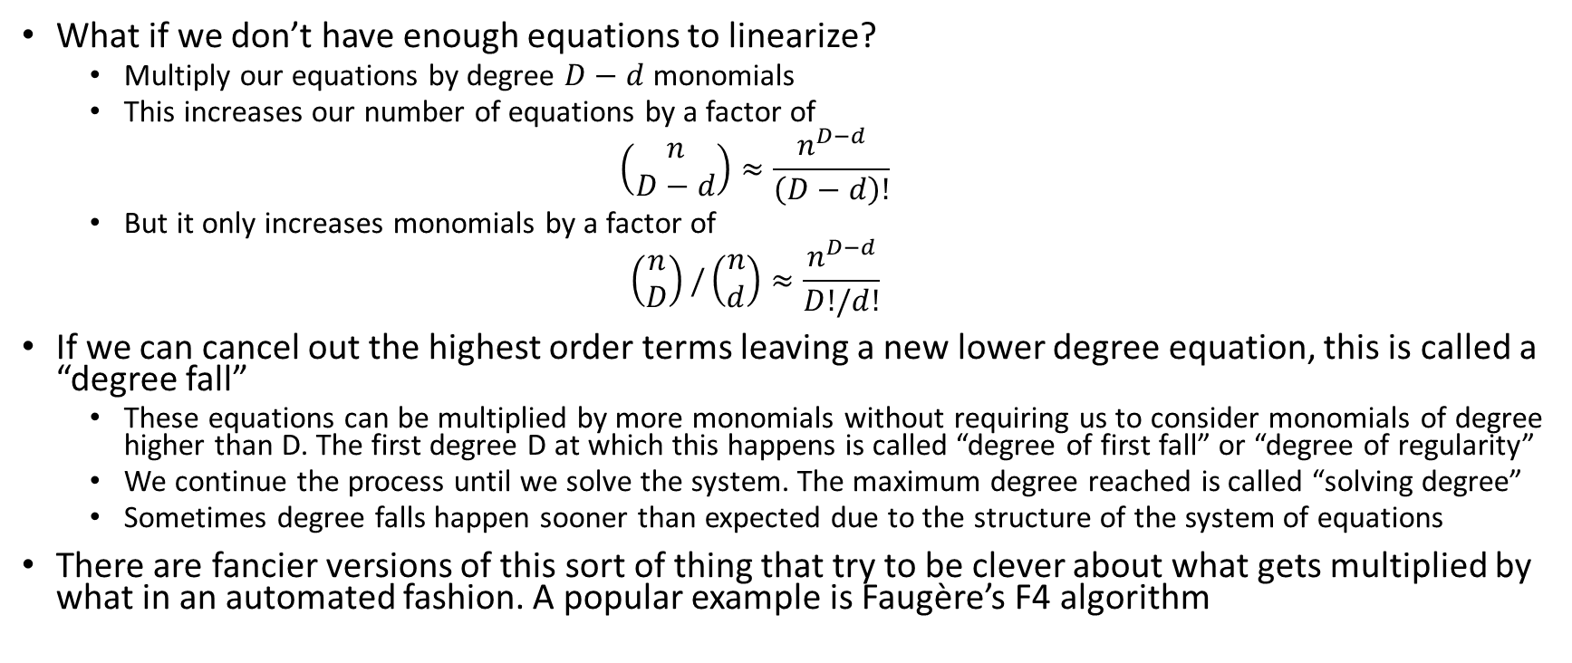
Extended Linearization (XL)
(and other Gröbner basis techniques)
What if we don’t have enough equations to linearize?
  Multiply our equations by degree $D−d$ monomials
  This increases our number of equations by a factor of
  $$\left(\begin{matrix}n \\ D−d\end{matrix}\right)≈\frac{n^{D−d}}{\left(D−d\right)!}$$
  But it only increases monomials by a factor of
  $$\left(\begin{matrix}n \\ D\end{matrix}\right)/\left(\begin{matrix}n \\ d\end{matrix}\right)≈\frac{n^{D−d}}{D!/d!}$$
If we can cancel out the highest order terms leaving a new lower degree equation, this is called a “degree fall”
  These equations can be multiplied by more monomials without requiring us to consider monomials of degree higher than D. The first degree D at which this happens is called “degree of first fall” or “degree of regularity”
  We continue the process until we solve the system. The maximum degree reached is called “solving degree”
  Sometimes degree falls happen sooner than expected due to the structure of the system of equations
There are fancier versions of this sort of thing that try to be clever about what gets multiplied by what in an automated fashion. A popular example is Faugère’s F4 algorithm

Slide 29
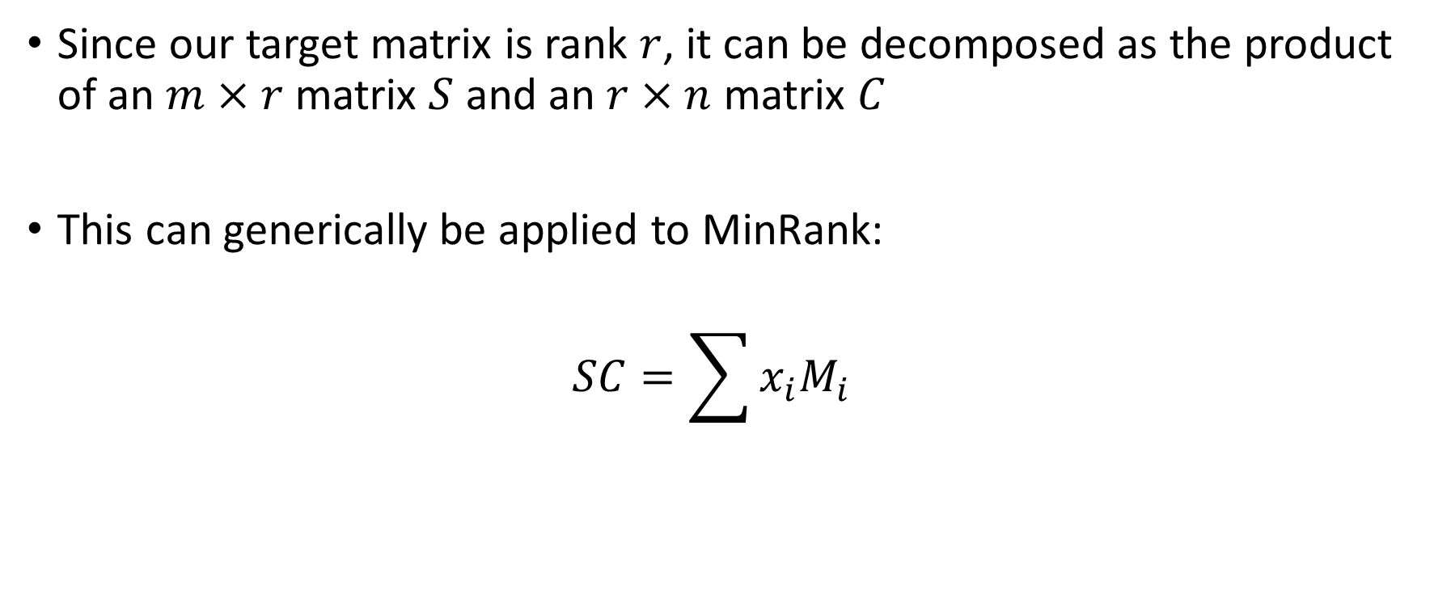
Rank Decomposition Modeling
[Bardet, Bros, Cabarcas, Gaborit, Perlner, Smith-Tone, Tillich, Verbel 2020]
Since our target matrix is rank $r$, it can be decomposed as the product of an $m×r$ matrix $S$ and an $r×n$ matrix $C$
This can generically be applied to MinRank:
$$SC=\sum{x_{i}M_{i}}$$

Slide 30
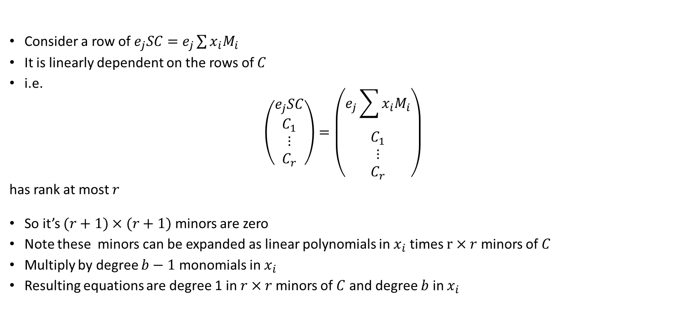
Support Minors Modeling
[Bardet, Bros, Cabarcas, Gaborit, Perlner, Smith-Tone, Tillich, Verbel 2020]
Consider a row of $e_{j}SC=e_{j}\sum{x_{i}M_{i}}$
It is linearly dependent on the rows of $C$
i.e.
$$\left(\begin{matrix}\begin{matrix}e_{j}SC \\ C_{1}\end{matrix} \\ \begin{matrix}⋮ \\ C_{r}\end{matrix}\end{matrix}\right)=\left(\begin{matrix}\begin{matrix}e_{j}\sum{x_{i}M_{i}} \\ C_{1}\end{matrix} \\ \begin{matrix}⋮ \\ C_{r}\end{matrix}\end{matrix}\right)$$
has rank at most $r$
So it’s $(r+1)×(r+1)$ minors are zero
Note these minors can be expanded as linear polynomials in $x_{i}$ times $r×r$ minors of $C$
Multiply by degree $b−1$ monomials in $x_{i}$
Resulting equations are degree 1 in $r×r$minors of $C$ and degree $b$ in $x_{i}$

Slide 31
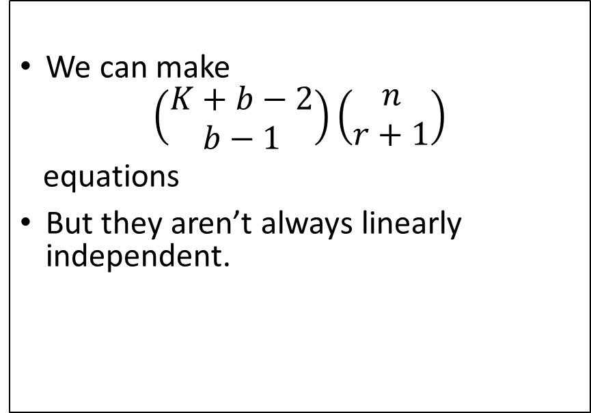
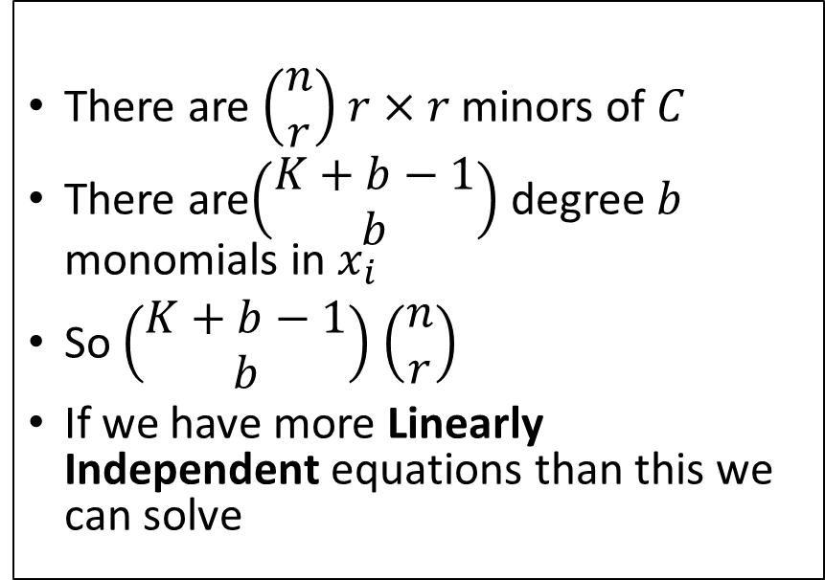
Support Minors Modeling – How Many:
Monomials?
Equations?
There are $\left(\begin{matrix}n \\ r\end{matrix}\right)$ $r×r$ minors of $C$
There are$\left(\begin{matrix}K+b−1 \\ b\end{matrix}\right)$ degree $b$ monomials in $x_{i}$
So $\left(\begin{matrix}K+b−1 \\ b\end{matrix}\right)$ $\left(\begin{matrix}n \\ r\end{matrix}\right)$
If we have more Linearly Independent equations than this we can solve
We can make
$$\left(\begin{matrix}K+b−2 \\ b−1\end{matrix}\right)\left(\begin{matrix}n \\ r+1\end{matrix}\right)$$
equations
But they aren’t always linearly independent.

Slide 32
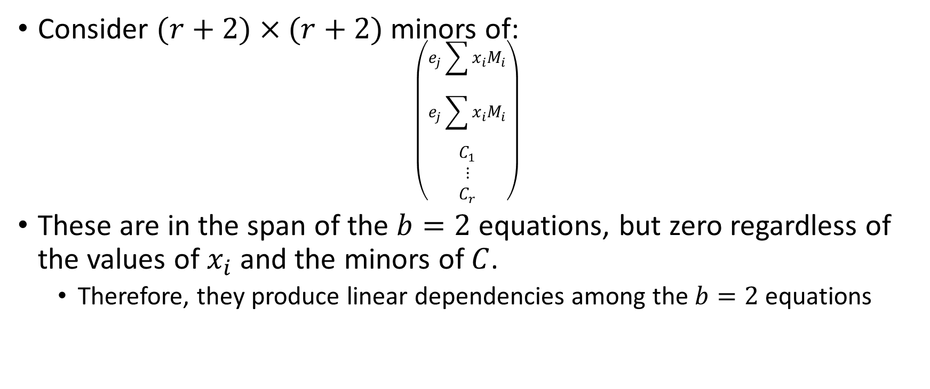
Support Minors Modeling: Linear Dependencies
Main Type
Consider $(r+2)×(r+2)$ minors of:
$$\left(\begin{matrix}\begin{matrix}\begin{matrix}e_{j}\sum{x_{i}M_{i}} \\ e_{j}\sum{x_{i}M_{i}}\end{matrix} \\ C_{1}\end{matrix} \\ \begin{matrix}⋮ \\ C_{r}\end{matrix}\end{matrix}\right)$$
These are in the span of the $b=2$ equations, but zero regardless of the values of $x_{i}$ and the minors of $C$.
  Therefore, they produce linear dependencies among the $b=2$ equations

Slide 33

Support Minors Modeling
Linear Dependencies: Main type; More general form
The same holds for:
$$\sum_{j,k}{T_{jk}\left(\begin{matrix}\begin{matrix}\begin{matrix}e_{j}\sum{x_{i}M_{i}} \\ e_{k}\sum{x_{i}M_{i}}\end{matrix} \\ C_{1}\end{matrix} \\ \begin{matrix}⋮ \\ C_{r}\end{matrix}\end{matrix}\right)}$$
Where $T_{jk}=T_{kj}$

Slide 34
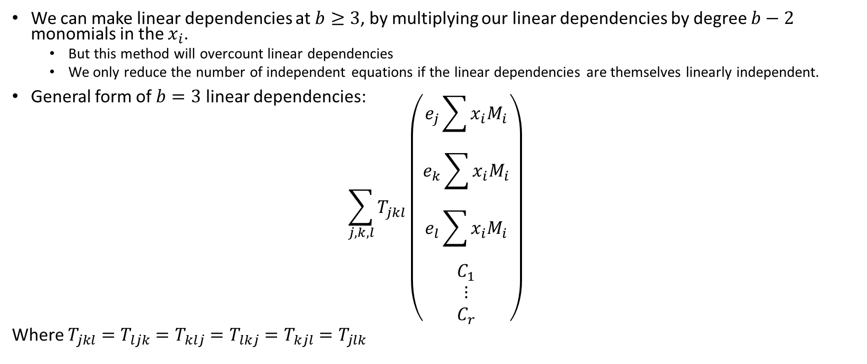
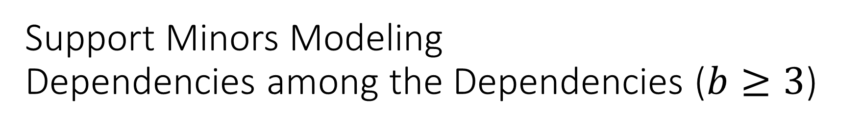
Support Minors Modeling
Dependencies among the Dependencies ($b≥3$)
We can make linear dependencies at $b≥3$, by multiplying our linear dependencies by degree $b−2$ monomials in the $x_{i}$.
  But this method will overcount linear dependencies
  We only reduce the number of independent equations if the linear dependencies are themselves linearly independent.
General form of $b=3$ linear dependencies:
$$\sum_{j,k,l}{T_{jkl}\left(\begin{matrix}\begin{matrix}\begin{matrix}\begin{matrix}e_{j}\sum{x_{i}M_{i}} \\ e_{k}\sum{x_{i}M_{i}}\end{matrix} \\ e_{l}\sum{x_{i}M_{i}}\end{matrix} \\ C_{1}\end{matrix} \\ \begin{matrix}⋮ \\ C_{r}\end{matrix}\end{matrix}\right)}$$
Where $T_{jkl}=T_{ljk}=T_{klj}=T_{lkj}=T_{kjl}=T_{jlk}$

Slide 35

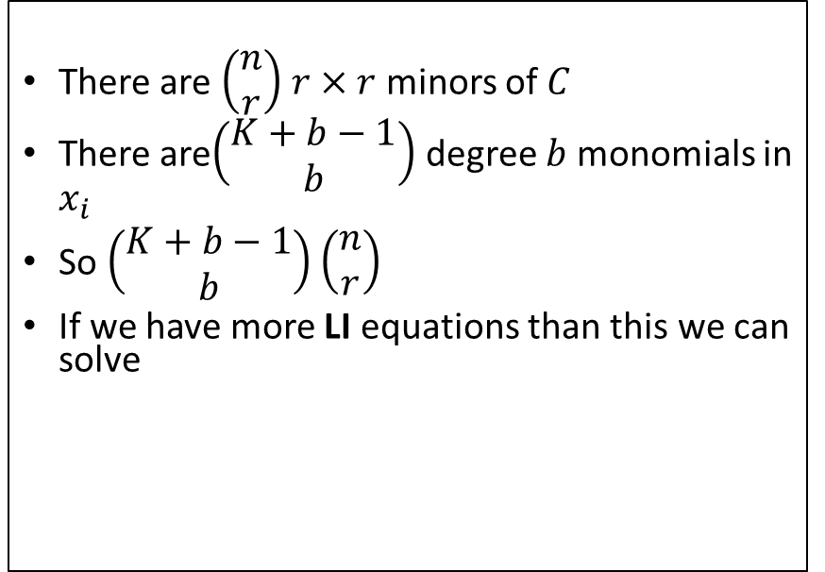
Support Minors Modeling – How Many:
Monomials?
Linearly Independent (LI) Equations?
There are $\left(\begin{matrix}n \\ r\end{matrix}\right)$ $r×r$ minors of $C$
There are$\left(\begin{matrix}K+b−1 \\ b\end{matrix}\right)$ degree $b$ monomials in $x_{i}$
So $\left(\begin{matrix}K+b−1 \\ b\end{matrix}\right)$ $\left(\begin{matrix}n \\ r\end{matrix}\right)$
If we have more LI equations than this we can solve
$$\sum_{i=1}^{b}{({−1)}^{i−1}\left(\begin{matrix}n \\ r+i\end{matrix}\right)\left(\begin{matrix}m+i−1 \\ i\end{matrix}\right)\left(\begin{matrix}K+b−i−1 \\ b−i\end{matrix}\right)}$$
Note: this formula only works when
$b<r+2$
  Read the paper to see why
Formula extensively tested with experiments
  can it be proven?
When we have more LI equations than monomials, we can solve!

Slide 36
Support Minors Modeling Quantitatively
Dramatically improves complexity of MinRank attacks, but does not break GeMSS or Rainbow
Tables from [Bardet, Bros, Cabarcas, Gaborit, Perlner, Smith-Tone, Tillich, Verbel 2020]

Slide 37
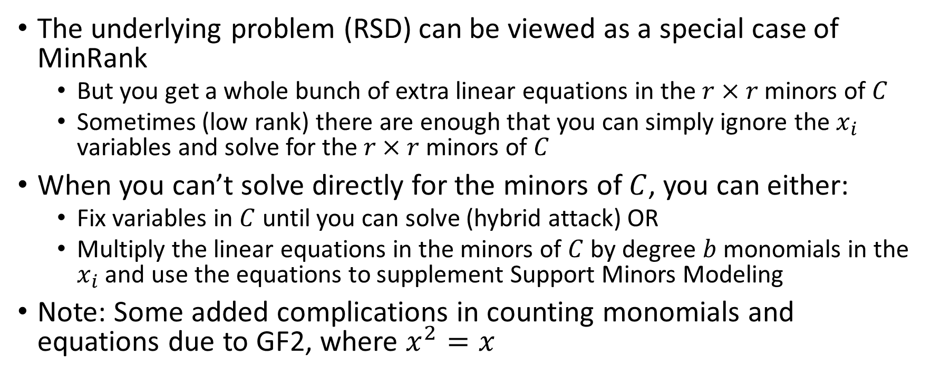
Application to Rank-Based Crypto
(ROLLO, RQC)
The underlying problem (RSD) can be viewed as a special case of MinRank
  But you get a whole bunch of extra linear equations in the $r×r$minors of $C$
  Sometimes (low rank) there are enough that you can simply ignore the $x_{i}$ variables and solve for the $r×r$minors of $C$
When you can’t solve directly for the minors of $C$, you can either:
  Fix variables in $C$ until you can solve (hybrid attack) OR
  Multiply the linear equations in the minors of $C$ by degree $b$ monomials in the $x_{i}$ and use the equations to supplement Support Minors Modeling
Note: Some added complications in counting monomials and equations due to GF2, where $x^{2}=x$

Slide 38
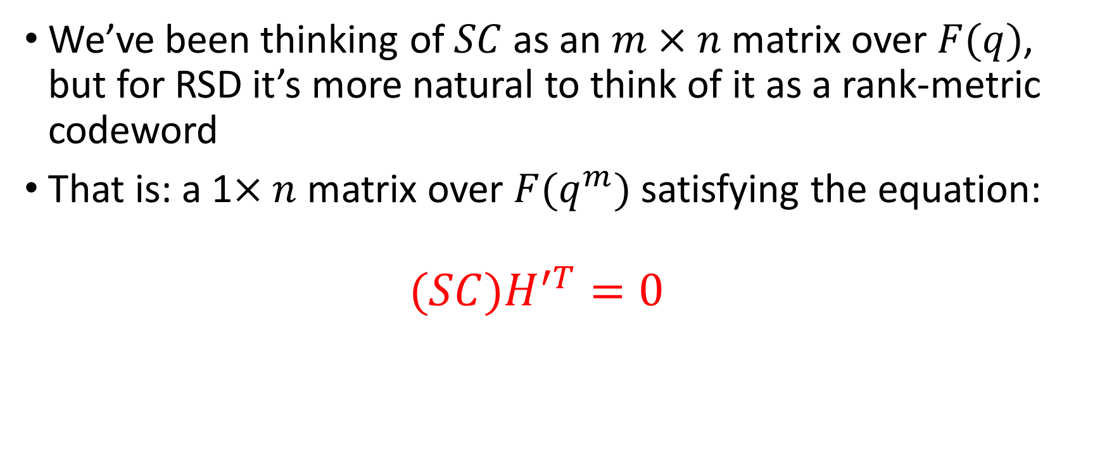
Extra equations for RSD 1: Syndrome Modeling
[Bardet, Briaud, Bros, Gaborit, Neiger, Ruatta, Tillich 2019]
We’ve been thinking of $SC$ as an $m×n$ matrix over $F(q)$, but for RSD it’s more natural to think of it as a rank-metric codeword
That is: a 1$×n$ matrix over $F(q^{m})$ satisfying the equation:
  $$(SC)H^{′T}=0$$

Slide 39
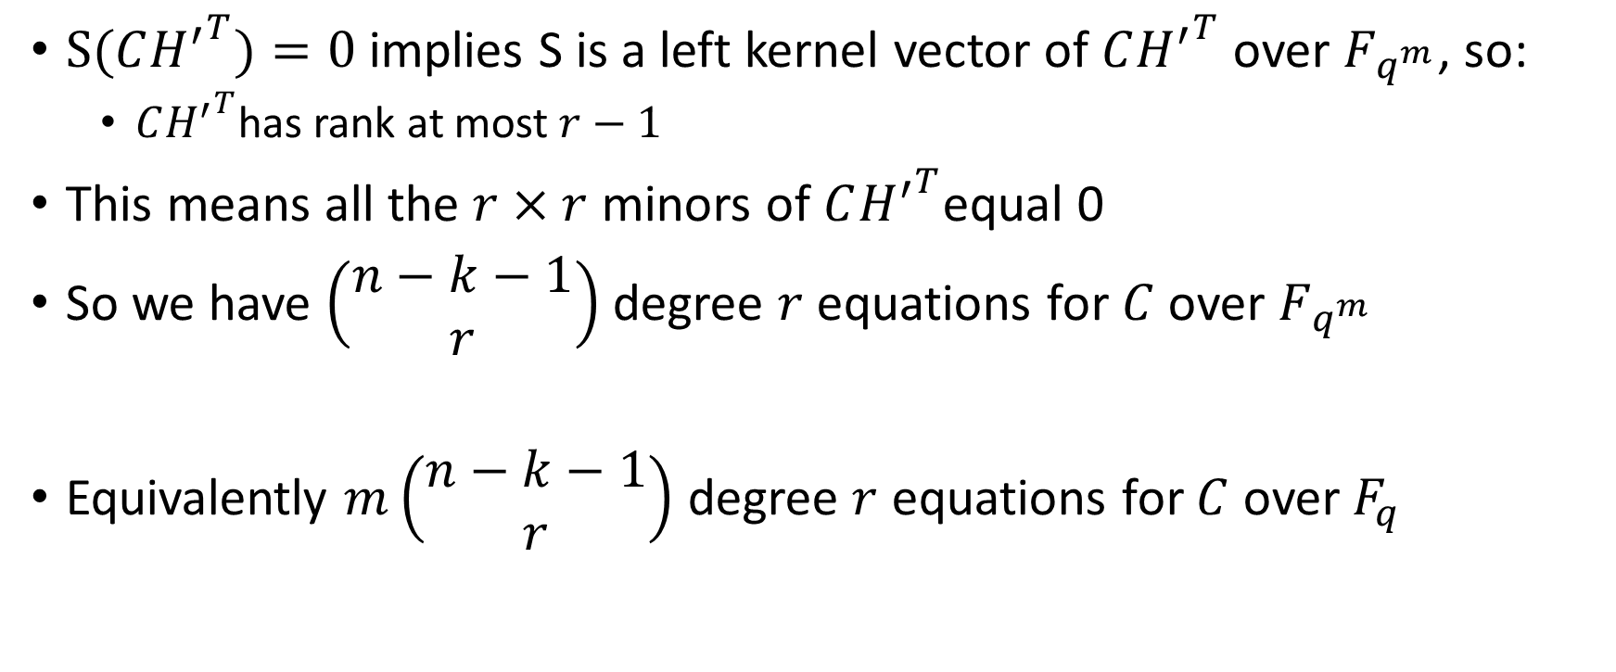

Extra equations for RSD 2:
MaxMinors($C{H′}^{T}$)
$S(C{H^{′}}^{T})=0$ implies S is a left kernel vector of $C{H^{′}}^{T}$ over $F_{q^{m}}$, so:
  $C{H^{′}}^{T}$has rank at most $r−1$
This means all the $r×r$ minors of $C{H^{′}}^{T}$equal 0
So we have $\left(\begin{matrix}n−k−1 \\ r\end{matrix}\right)$ degree $r$ equations for $C$ over $F_{q^{m}}$
Equivalently $m\left(\begin{matrix}n−k−1 \\ r\end{matrix}\right)$ degree $r$ equations for $C$ over $F_{q}$

Slide 40
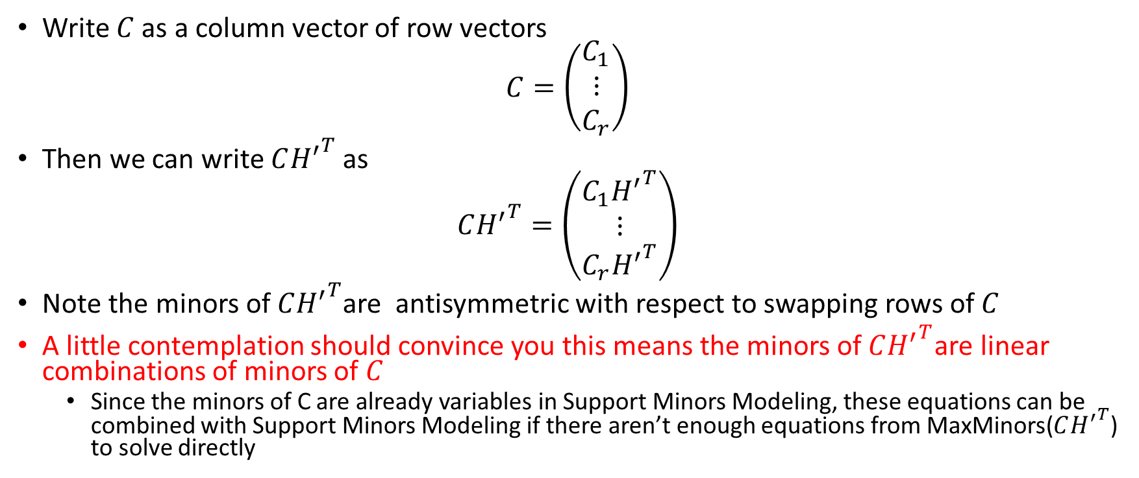

Extra equations for RSD 3:
How to use MaxMinors($C{H^{′}}^{T}$) to solve for $C$
Write $C$ as a column vector of row vectors
$$C=\left(\begin{matrix}C_{1} \\ ⋮ \\ C_{r}\end{matrix}\right)$$
Then we can write $C{H^{′}}^{T}$ as
$$C{H^{′}}^{T}=\left(\begin{matrix}C_{1}{H^{′}}^{T} \\ ⋮ \\ C_{r}{H^{′}}^{T}\end{matrix}\right)$$
Note the minors of $C{H^{′}}^{T}$are antisymmetric with respect to swapping rows of $C$
A little contemplation should convince you this means the minors of$C{H^{′}}^{T}$are linear combinations of minors of $C$
  Since the minors of C are already variables in Support Minors Modeling, these equations can be combined with Support Minors Modeling if there aren’t enough equations from MaxMinors($C{H^{′}}^{T}$) to solve directly

Slide 41

Support Minors + MaxMinors($C{H^{′}}^{T}$)
Quantitatively
This attack approach approximately halved the bits of security provided by ROLLO and RQC
Tables from [Bardet, Bros, Cabarcas, Gaborit, Perlner, Smith-Tone, Tillich, Verbel 2020]

Slide 42
Conclusion
Techniques for solving MinRank have a wide variety of applications in cryptanalysis
There has been recent improvement especially in algebraic techniques for solving Minrank
Sometimes MinRank instances derived from cryptosystems have extra structure that makes them easier than generic systems
Nonetheless, MinRank appears asymptotically hard, so secure cryptosystems whose security depends on the hardness of MinRank (including more structured variants) seem possible
Recent Progress suggests the need for more study!

Slide 43
Thank You!

